Slide 2
MICROSERVICES DESIGN PATTERNS
Feb 19, 2024

Slide 3
Agenda
What is microservices
Principles of microservices
Why we need design patterns
What is design patterns
Types of design patterns

Slide 4
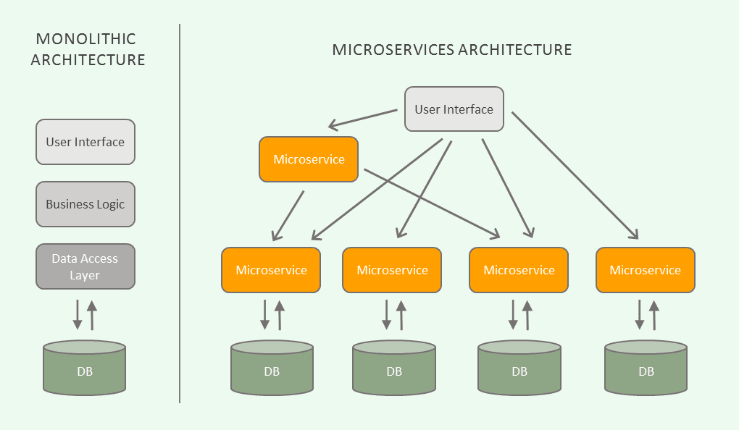
What is Microservice
Microservices are an architectural approach to developing software applications as a collection of small, independent services that communicate with each other over a network.

Slide 5
Principles of Microservices
Independent and Autonomous/Self-governing services
API aggregation
Flexibility
Scalability
Constant monitoring
Failure Isolation/ Failure resilience
Realtime Load balancing
Inclusion of DevOps
Versioning
Availability

Slide 6
Why we need design patterns
By using design patterns ,the team working on various projects use the same pattern to build similar application
Amazon
flipkart
Myntra
Works successfully shows few errors shows few errors

Slide 7
What is design pattern
Software design pattern can be defined as a software template or a description to solve a problem that occurs in multiple instances while design a software application or a software framework.

Slide 8
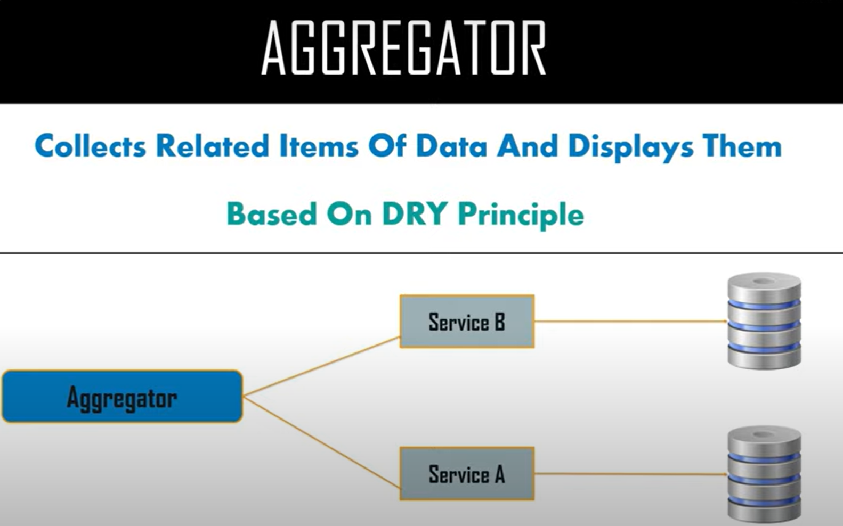
Microservices design patterns

Slide 9


Slide 10
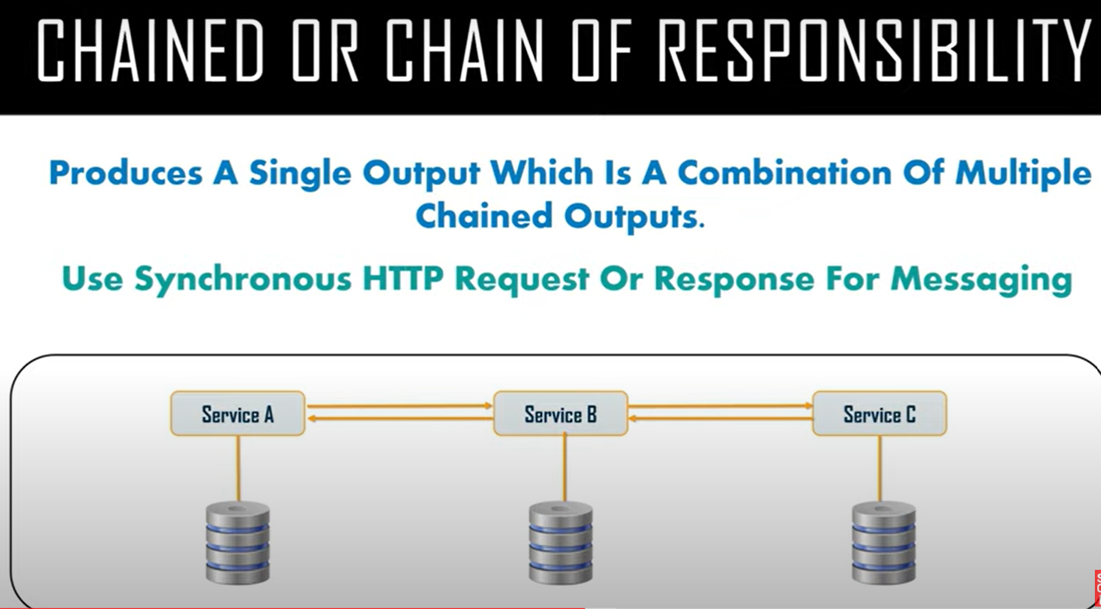

Slide 11
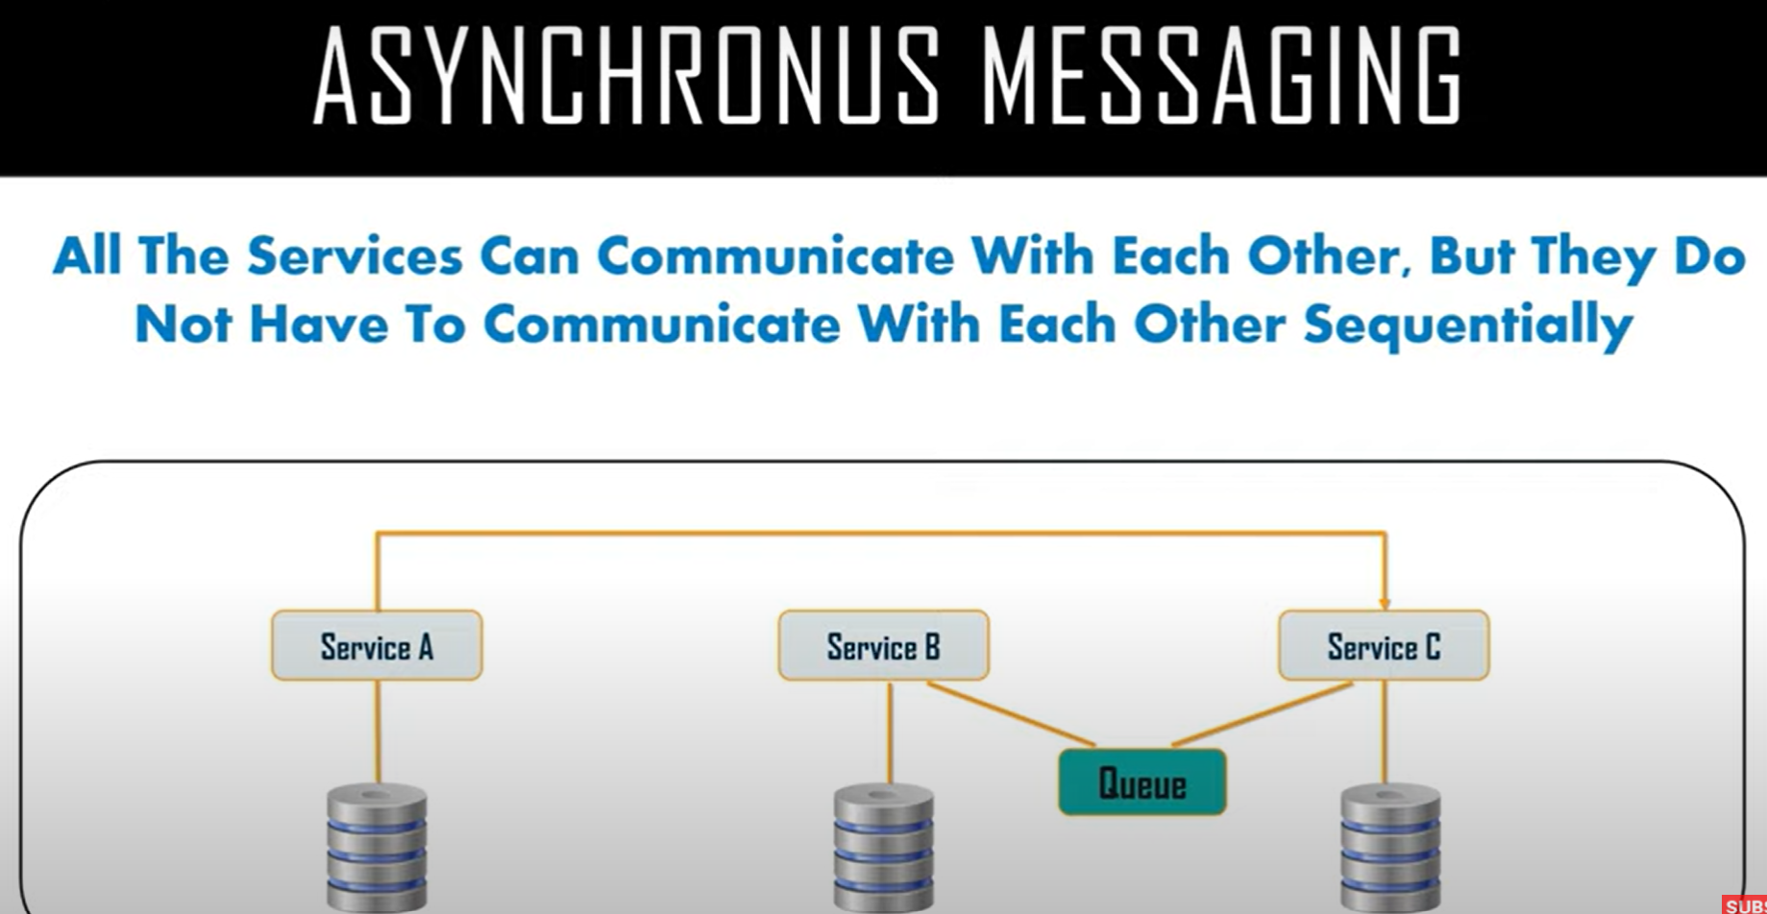

Slide 12
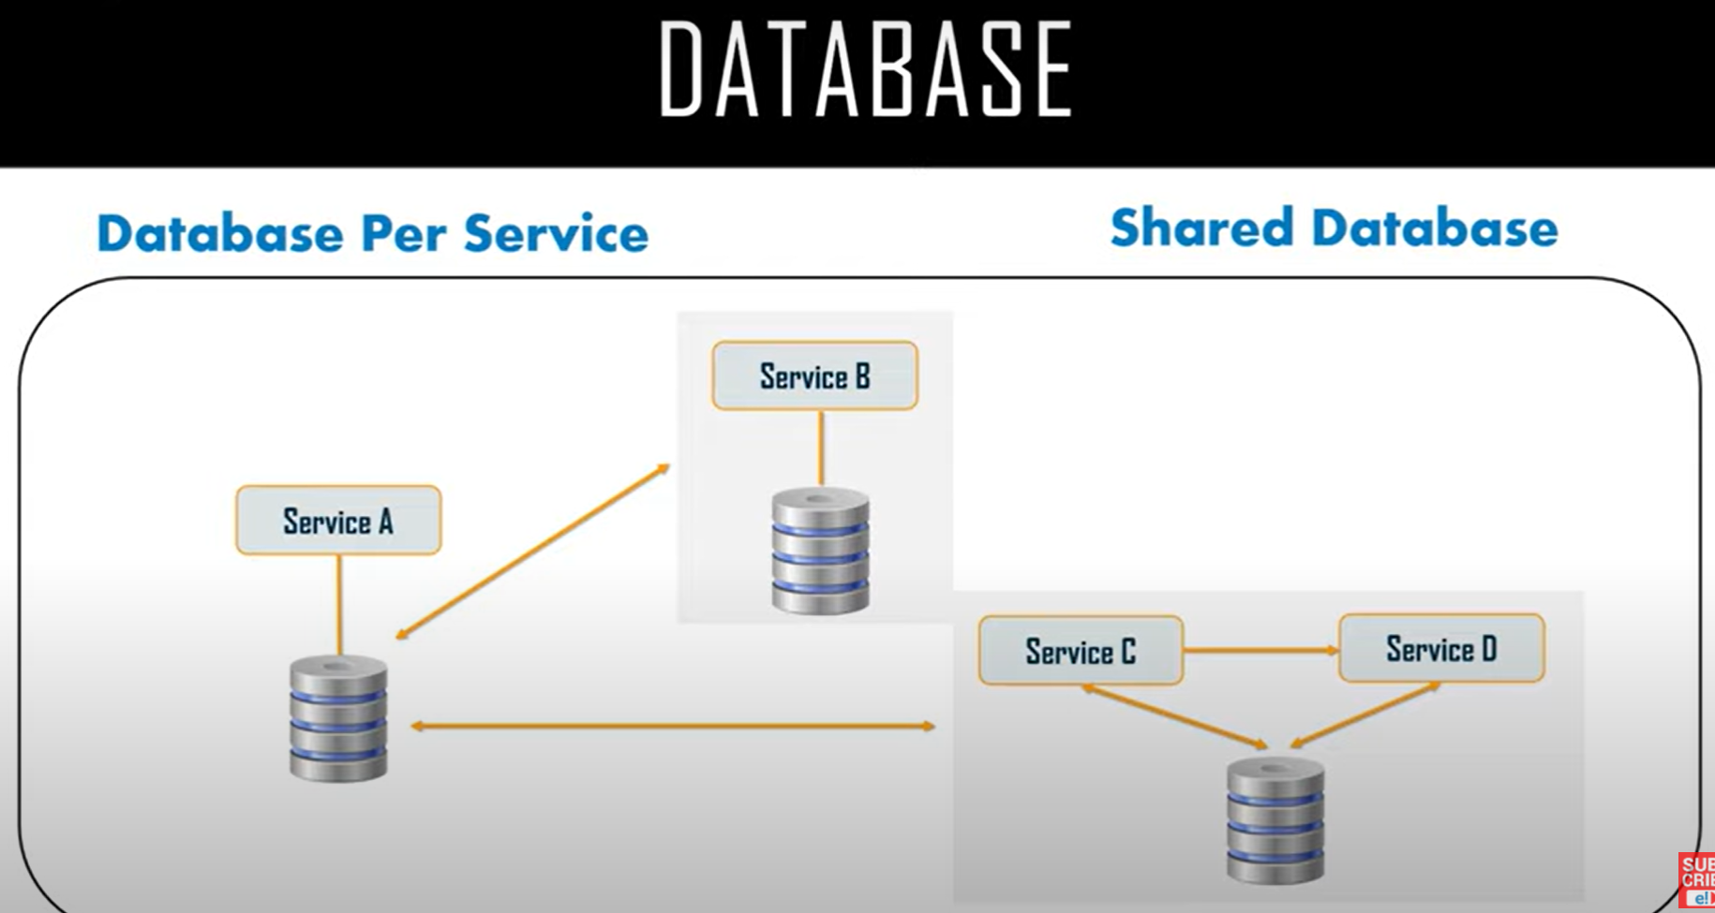

Slide 13
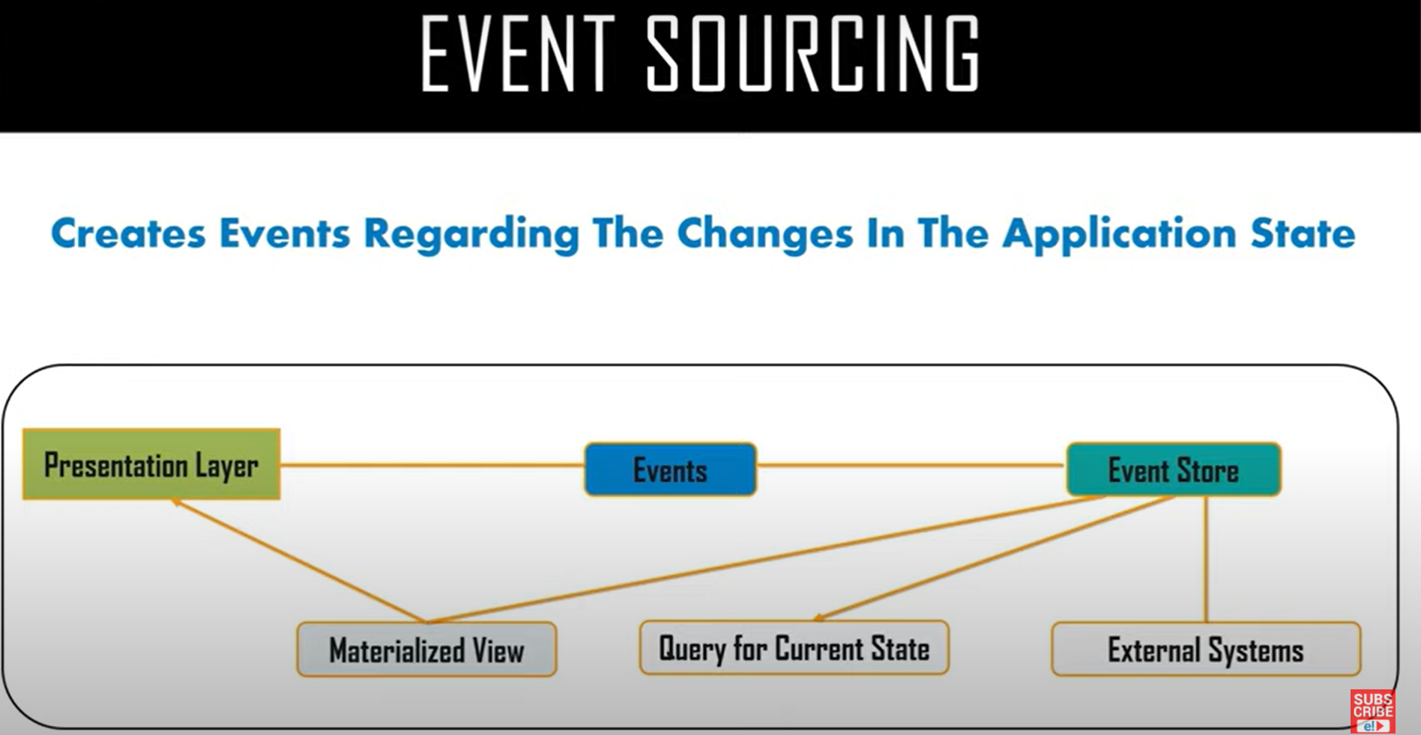

Slide 14
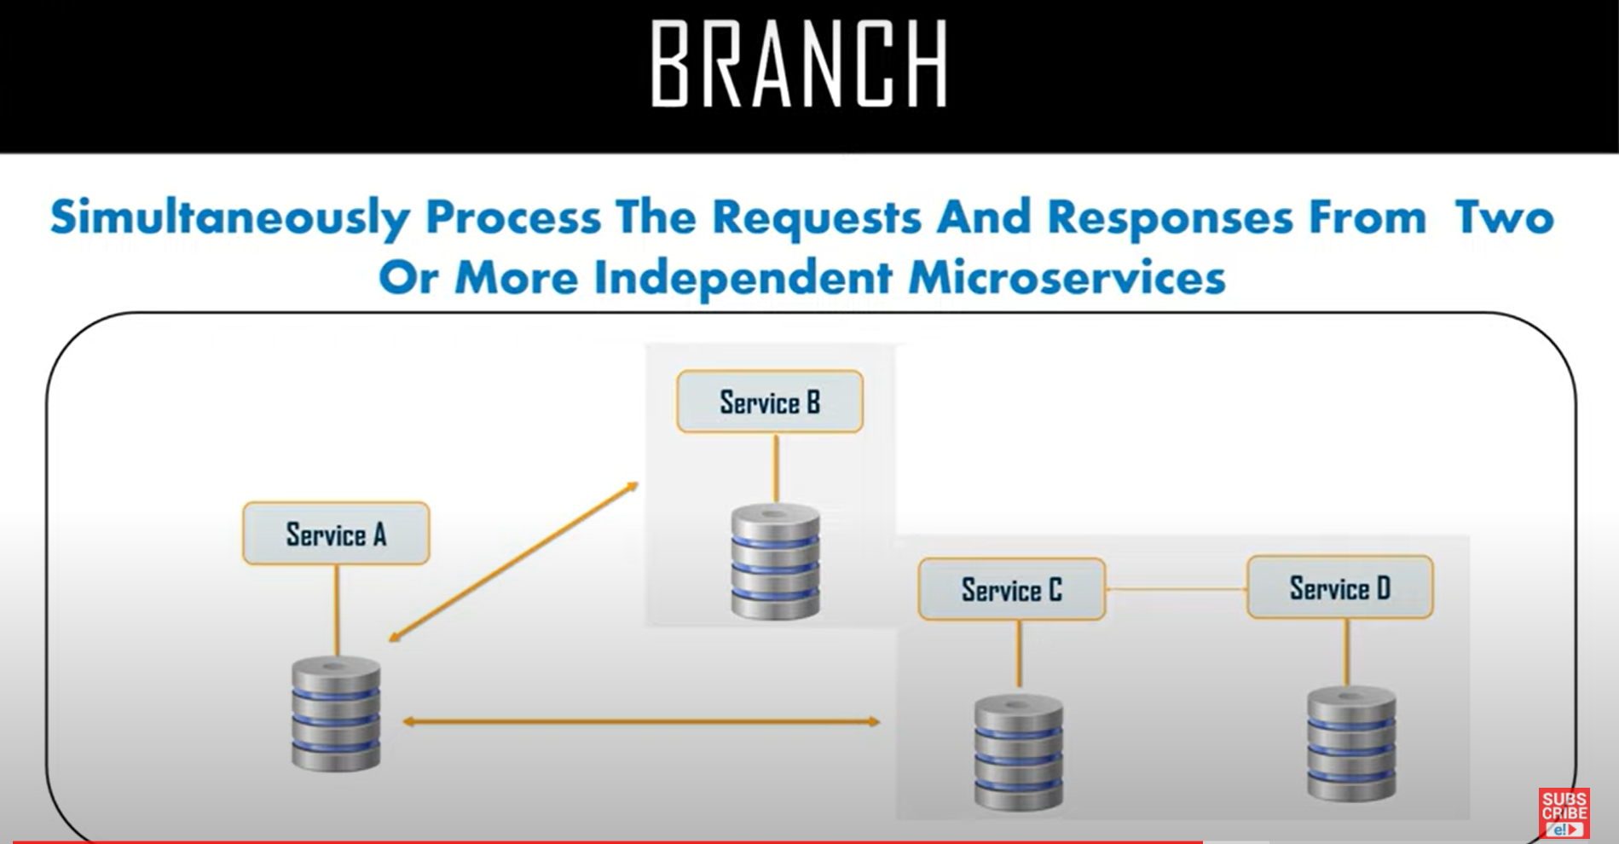

Slide 15
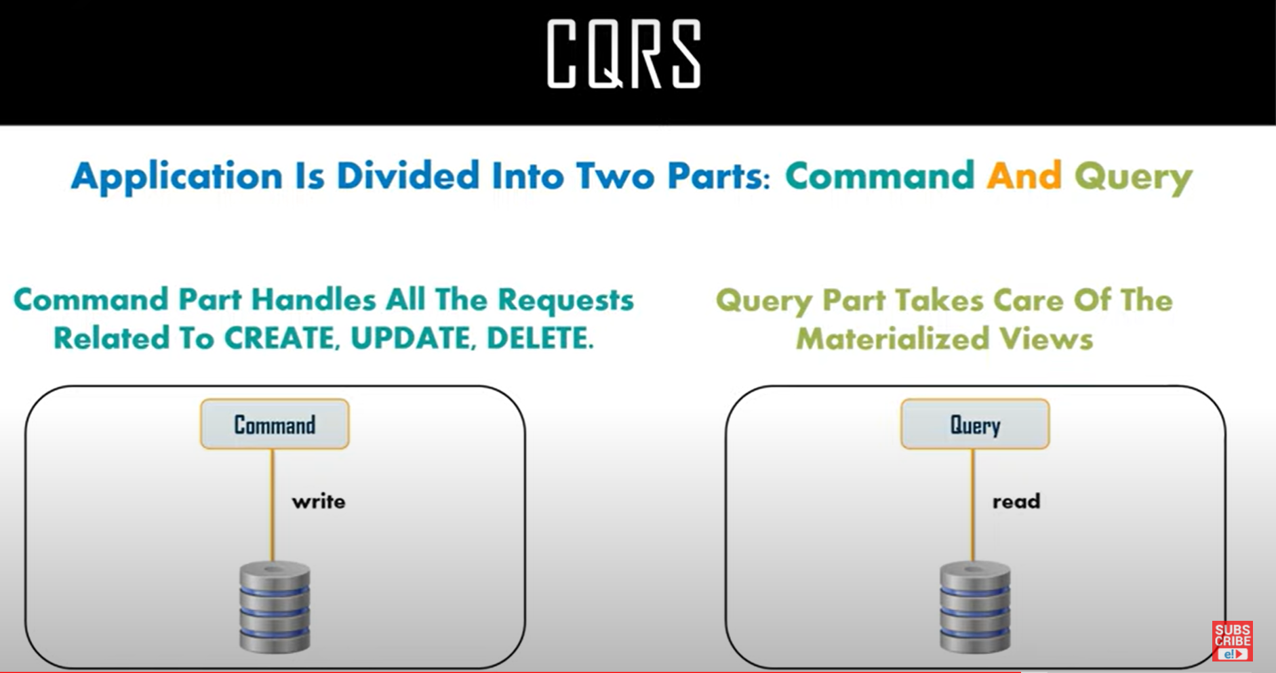

Slide 16
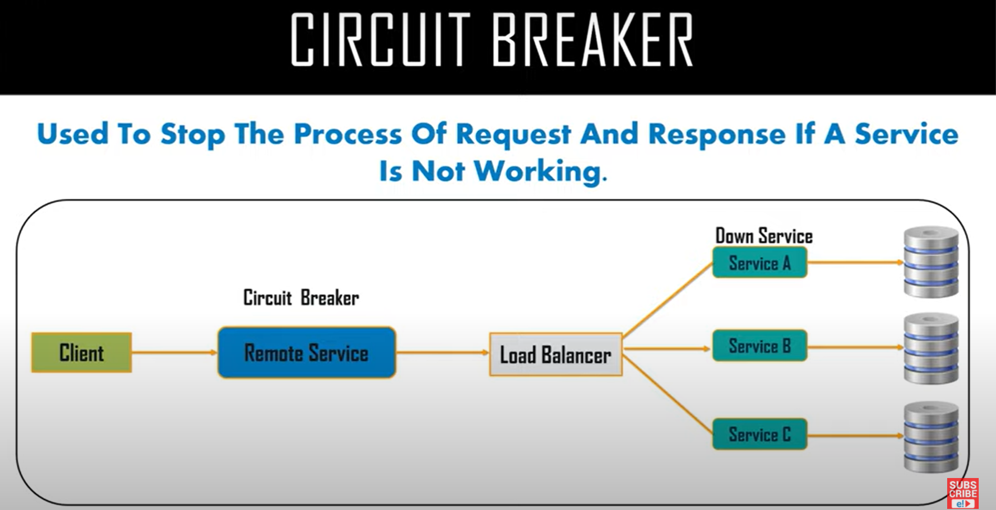

Slide 17
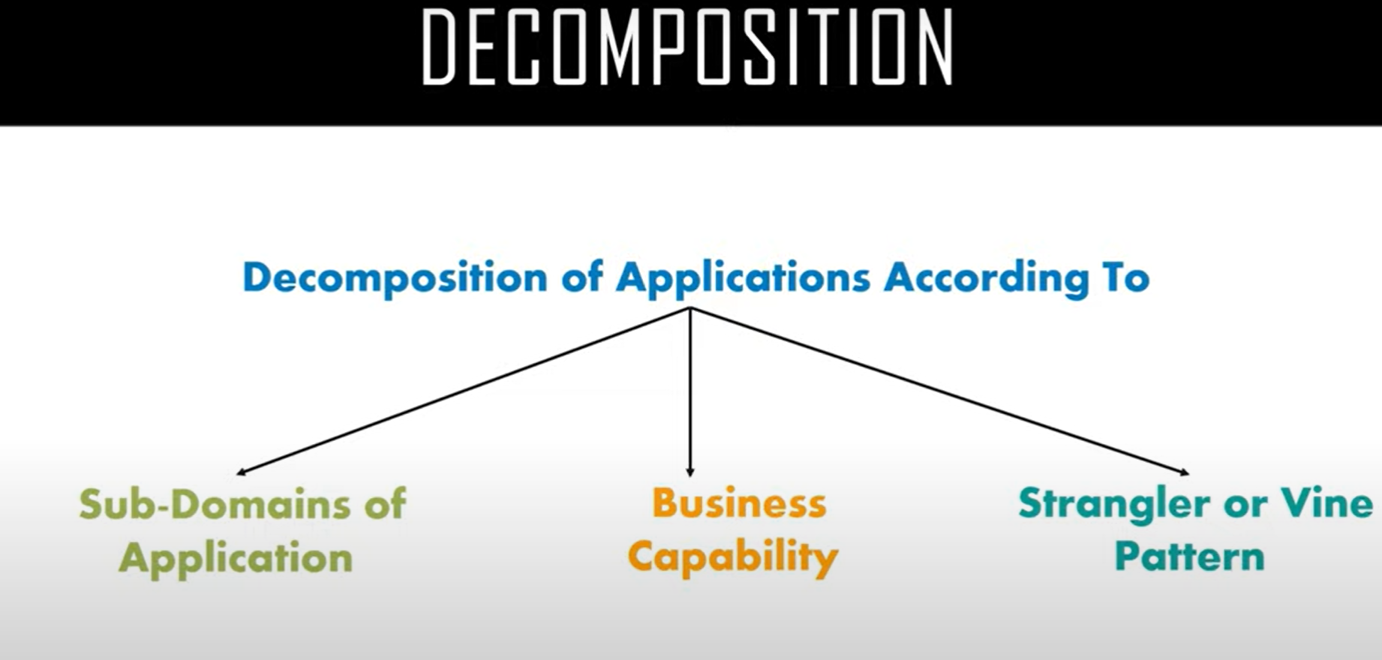

Slide 18
Domain Design Driven
Domain-driven design (DDD) provides a framework that can get you most of the way to a set of well-designed microservices. DDD has two distinct phases, strategic and tactical. In strategic DDD, you are defining the large-scale structure of the system. Strategic DDD helps to ensure that your architecture remains focused on business capabilities. Tactical DDD provides a set of design patterns that you can use to create the domain model. These patterns include entities, aggregates, and domain services. These tactical patterns will help you to design microservices that are both loosely coupled and cohesive.

